Slide 1
Event Listeners
By Caleb Olsson
Notes:
Hello friends, my name is Caleb Olsson
First off, credit to w3schools and MDN web docs

Slide 2
addEventListener()
target.addEventListener(type, listener);
type: What event to be listening for, eg. click, scroll, focus, keydown, etc.
listener: Often a JavaScript function, or any object with a handleEvent() method
The recommended method for setting up event listeners
May target elements, their children, the Document, the Window, and more*
The target of the event listener may have more than one handler
*The above information was quoted and paraphrased from:
https://developer.mozilla.org/en-US/docs/Web/API/EventTarget/addEventListener
🔗
🔗
Notes:
There are other ways to set up event listeners, but this is the optimized way, so it is the only way we will talk about today
The target may have multiple event listeners, and they might even interact based on what Java script code you trigger in what order

Slide 3
target.addEventListener(type, listener);
type (type of event)
listener (what happens)
Detect clicks, scrolls, key presses, and similar inputs
Detect clipboard events
Detect changes in window focus
Detect form submissions and other html tracked user inputs
Detect media use and messaging
Detect mouse hover, touchscreen selections, and text selections
Ideas for JavaScript functions:
Submitting form input
Doing user requested math
Changing html elements or attributes, or css rules
Beginning or ending an animation
Listeners can also be objects
The object must have an eventHandler() function
Ultimately still calls a JavaScript function, just in a different way
Notes:
Dblclick, click, rightclick, scroll, mouse on/off (which has overlap with the css ::hover) window focus, and more
You can write and function and cite it as the listener, and there are even additional options that you may add like “once”

Slide 4


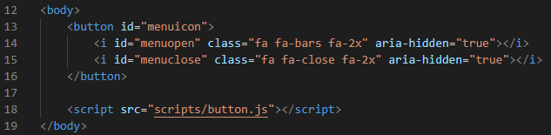
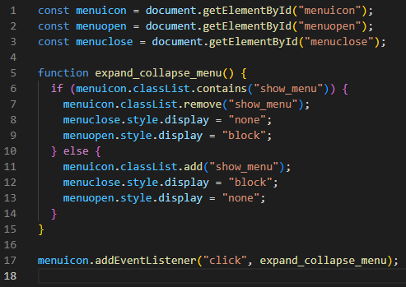
listener
addEventListener
type
target. ( , );
17
click
expand_collapse_menu
menuicon. (" ", );
addEventListener
Notes:
Lets talk about an example that I will be demonstrating shortly. *review the section of html, then click through line 17*
Now lets see some of this in action using my handy dandy demonstration document

